Slide 1
Invertebrate
Prepared by
Prof. Dr. Sabeeh H. Al-Mayah

Slide 2
Introduction to Invertebrates & Principles of Classification of Organisms

Slide 3
Introduction to Invertebrates
The majority of the species that inhabit the earth are animals
Some possess a backbone or vertebral column, but many do not.
Animals throughout the world are divided into two major groups; those that possess a backbone (vertebrates) and those that do not (invertebrates)
These groupings are based largely on tradition and convenience rather than natural biological differentiation

Slide 5
Invertebrates are animals with no internal skeleton or backbone. Invertebrates makeup about 95% of all animals species on earth.
Types of invertebrates include annelids, arachnids, cnidaria, crustacea, echinoderms.
Many invertebrares have a fluid-filled skeleton like jellyfish or worm , other invertebrates have hard outer shell like insects and crustacea.

Slide 6
Introduction to Invertebrates contd:
Invertebrates are found in all habitats including the depths of the oceans and on glacial ice
Invertebrates serve various important ecological roles including consumption and reduction of organic matter, decomposition, and as a food source
In this course, we will study biology and diversity of the invertebrates; building an understanding of the evolutionary relationships and taxonomic classification of the invertebrates as currently understood
We will also highlight some sub-disciplines of invertebrate zoology such as entomology and parasitology

Slide 7
Definition of terms
Diversity: Measure of success through adaptation and variation.
It is characterized by number of species
Abundance: Measure of the specialization and successful competition, often in particular environmental conditions
It is characterized by number of individuals

Slide 8
Biological Species Concept
The term species was first proposed by John Ray, an English clergyman and scientist, around 1700. He pointed out that all individuals that belong to a given species breed with one another and produce fertile progeny. This concept is still used today
breeds of dogs are one species, as they can all interbreed, even if some individuals look so different
Ernst Mayr, an American, the father of population genetics and an evolutionist, has redefined the concept, pointing out that “species are groups of actually or potentially interbreeding natural populations which are reproductively isolated from one another”
The biological species concept works fairly well for animals where there are strong barriers to hybridization between species

Slide 9
Biological Species Concept
Animals regularly outcross, and so the concept works well. Outcrossing is less common in other kingdoms
Species in the other kingdoms-bacteria, fungi, etc do not outcross/interbreed with one another as many reproduce asexually and so cannot be characterized in the same way as outcrossing animals and plants
Most species can be separated by fairly obvious anatomical, physiological and behavioral characters but the final and key separation criterion is reproduction, i.e. whether or not there is actual or potential gene flow

Slide 10
Classification of Living things
The earth is inhabited by millions of different kinds of organisms. In order to study them, we need to group (classify) them and give them names
Classification of organisms refers to the process of putting together organisms that bear resemblance to one another
Taxonomy refers to the science of classifying organisms into natural groupings
Biosystematics is the science through which life forms are discovered, identified, described, named, classified and catalogued, with their diversity, life histories, living habits, roles in an ecosystem, and spatial and geographical distributions recorded. It can also be defined as the study of the kinds and diversity of organisms and the relationship between them
Organisms were first classified more than 2000yrs ago by Aristotle (Greek) into plants or animals. Later on, this simple classification was expanded by the Romans who grouped animals into units/groups called genera (sing: genus)
E.g. the cats were assigned the genus Felis, horses to genus Equus etc

Slide 11
Classification
A. Arrangement in classes or groups to improve communication between scientists.
Four factors used to classify
1. They have similar structures
2. They have similar behaviors
3. They eat the same kinds of things
4. They have the same chemical make up.

Slide 12
Unit 6 Lesson 6 Classification of Living Things
How do scientists know living things are related?
Chemical characteristics can indicate whether organisms are similar or related.
Scientists use genetic material to look for mutations and genetic similarities.
Proteins and hormones also can show if organisms are related.
Copyright © Houghton Mifflin Harcourt Publishing Company
Notes:
12

Slide 13
Unit 6 Lesson 6 Classification of Living Things
How do scientists know living things are related?
Physical characteristics can indicate that two organisms are similar or related.
Scientists also study how organisms develop from an egg to an adult to determine if organisms are related.
Copyright © Houghton Mifflin Harcourt Publishing Company
Notes:
13

Slide 14
Binomial nomenclature
Until 250 years ago, biologists used to add a series of descriptive terms to the name of the genus when they wanted to refer to a particular kind of organisms (species). There were so many phrases used and the system was known as Polynomial system
Swedish biologist; Carolus Linnaeus(1707-78) simplified the system into a Binomial nomenclature system in which a species is given a name consisting of two words; first word, refers to the name of the genus in which that species belongs and the second word, refers to a designation for that particular species. The combination of the two words constituted scientific name for the species
E.g. Honey bee is scientifically named Apis melifera

Slide 15
Binomial nomenclature contd:
Scientific names serve the purpose of avoiding confusion since any scientific name is the same regardless of your native language or geographical position and that no more than one organism can have the same scientific name
This can be accomplished because there are sets of international rules on naming living things; The International Code of Zoological Nomenclature (ICZN) which deals with animals and heterotrophic protozoans, The International Code of Botanical Nomenclature (ICBN) for plants, fungi, algae, and photosynthetic protozoans, and The International Code of Nomenclature of Bacteria (ICNB) for bacteria and archaea. Scientists try to adhere to these codes closely.

Slide 16
Binomial nomenclature contd:
Normally, scientific names are italicized or underlined, with the generic name capitalized and the specific name all in small case letters.
Upon first mention of a species in any write up, full name must be given, but the name can be abbreviated to the first letter of the genus and the species name in subsequent mention.
However, in some cases, particularly in the mosquito literature, the genus name abbreviation consists of two letters, Ae. for Aedes, An. for Anopheles, Cx. for Culex, Cs. for Culiseta, and so on.
Sp. and Spp.: When dealing with organisms for which, for various reasons, we know the genus, but not the species, the organism is identified by the generic name followed by the abbreviation "sp“. The plural abreviation "spp." is usually used to refer to all the individual species within a genus. i.e. sp.= single species spp.= plural, several species. These abbreviations can also be used when the names of the specific species is not important to the subject under discussion.

Slide 17
Linnaeus Classification
Linnaeus reorganized 7 categories of classification: species, genus, family, order, class, phylum and kingdom in a hierarchical order
Each category in the hierarchy is a collective unit containing one or more groups from the next lower level
A genus is a group of closely related species; a family is a group of related genera; an order is a group of closely related families etc
From evolutionary point of view, species in any one genus are believed to be more closely related than to species in any other genus

Slide 18
Unit 6 Lesson 6 Classification of Living Things
What are the levels of classification?
Domain
Kingdom
Phylum
Class
Order
Family
Genus
Species
Copyright © Houghton Mifflin Harcourt Publishing Company
Notes:
18

Slide 19
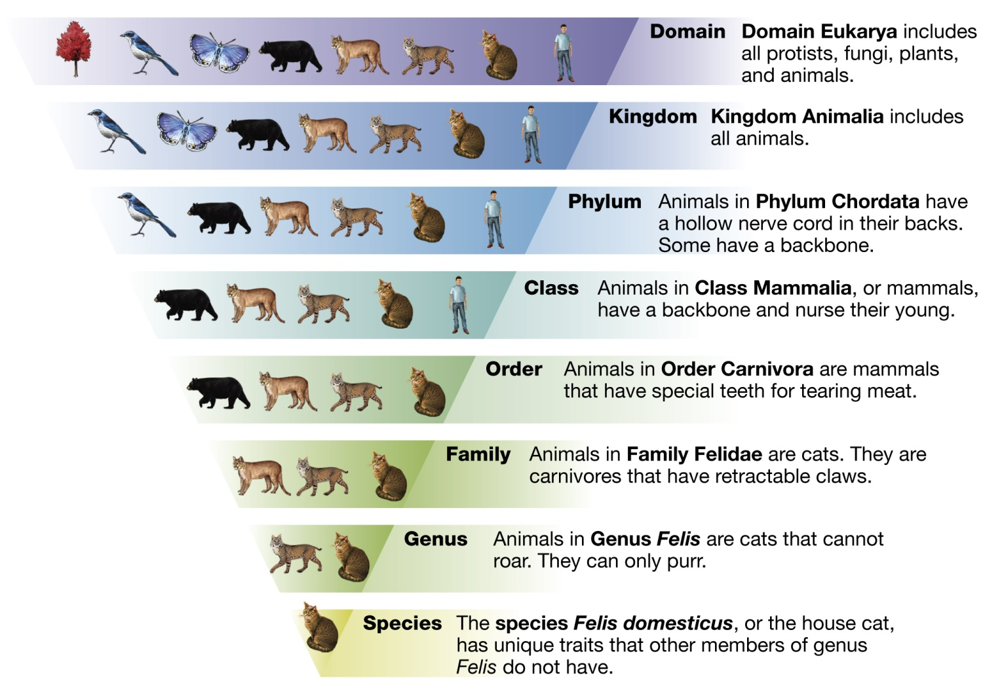
Unit 6 Lesson 6 Classification of Living Things
What are the levels of classification?
Copyright © Houghton Mifflin Harcourt Publishing Company
Notes:
19

Slide 20
Unit 6 Lesson 6 Classification of Living Things
How do classification systems change?
Millions of organisms are not named.
New organisms do not always fit into the existing classification system.
Scientists are constantly changing their thoughts on classification based on new information.
Copyright © Houghton Mifflin Harcourt Publishing Company
Notes:
20

Slide 21
Kingdoms of the Living Things
In his classification schem,Linnaeus(1735)
Recognized only two kingdoms of living
things:Animalia and Plantae.At the time, microscopic organisms had not been studied in detail.They were placed either in a separate category called Chaos or,in some cases;they were classified with plants or animals.

Slide 22
Kingdoms
In the 1860s,the German investigator Ernst Haeckel
Proposed a three-kingdom system of classification.
Haeckel’s three kingdoms were Animalia, plantae ,
And Protista. Members of the kingdom protista included the protozoa,fungi,bacteria,and other micro –organisms.
Haeckel’s system was not widely accepted,however,
and microrganism continued to be classified as plant
(for example,bacteria and fungi)or animals(protozo)

Slide 23
5 Kingdoms
Until recently the system devised by Robert Whitta-
Ker in 1968 was widely adopted.
Whittaker’s classification schem recognizes five ki-
ngdoms: Monera,protista, Fungi,Plantae,and Anima
lia.It is based mainly on differences in nutrition;his
Plantae were mostly multicellular autotrophs, his
Animalia multicellular heterotophs,and his Fungi
Multicellular saprotrophs. The remaining two kingd
Oms,protista and Monera,included unicellular(colon

Slide 24
6 Kingdom
Based on RNA studies Carl Woese divided the pro
Karyotes (kingdom Monera) into two kingdoms ,
Called Eubacteria and Archaebacteria .Carl Woese
Attempted to establish a three primary kingdom (or
Urkingdom)system in which plants, Animals,protist
And Fungi were lumped into one primary kingdom
All eukaryotes.the Eubacteria and Archaebacteria
Made up the other two urkingdom.

Slide 26
THANK YOU

